Slide 1


Entrepreneur’s Network
Virtual Entrepreneurship & Innovation Hub
EDIP Service Providers
Presented by Ehab Mustafa
Notes:
This presentation demonstrates the new capabilities of PowerPoint and it is best viewed in Slide Show. These slides are designed to give you great ideas for the presentations you’ll create in PowerPoint 2010!
For more sample templates, click the File tab, and then on the New tab, click Sample Templates.

Slide 2


What is Entrepreneur’s Network?
Commercial transactions (buying/selling) between entrepreneurs
Marketing products/services to SMEs
Invitations to forums/exhibitions IN & OUT of Bahrain
Linkages for joint ventures/partnerships

Slide 3


What are the advantages?
It is easier to find suppliers with unique offers
Discounted rates
Package deals
Payment Plans
Easily access the SME market segment
Promoted to other EDIP entrepreneurs

Slide 5
What do I need to sign-up?

Slide 6


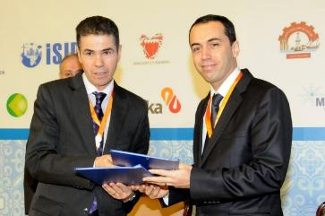
Intel & UNIDO Strategic Engagement
UNIDO – Arab International Center for Entrepreneurship & Investment
Enterprise Development & Investment Promotion Program
MoU Collaboration Areas
  Developing entrepreneurship and innovation.
  Create new knowledge and innovation to boost rate of technology adaption in MENA.
  Enhancing innovation among MENA countries through policy advisory services.
  Empowering women / closing digital gender divide especially in Africa.
Link to MOU signing ceremony

Slide 7
Intel & UNIDO Virtual Innovation Hub Value Proposition
In order to… | Develop entrepreneurship and innovation as fundamental drivers of sustainable growth in the MENA region and beyond
Intel & UNIDO Team will… | Use technology to catalyze innovation movement by creating online platform for enterprise development and Investment to increase access to innovation resources ( skills development , business counseling and funding) Create a community of international innovation ecosystem to integrate and link people, share innovation experience , best practices , technology tie up.
We can do this because… | Have solid track record of programs and impact to enable innovation. International reach and standards , ability to connect with international ecosystem to create partnership and scale.
Our efforts will result in… | Increasing employability and entrepreneurship in MENA region and creating 100,000 enterprises by 2020. Accelerating development & National Competitiveness goals for the MENA policy makers.

Slide 8
Objectives of the Online Platform
1
Facilitate and improve learning for both F2F and Virtual Training
2
Scale to tens of thousands of participants
through virtual training and online platform
3
Increase the reach to participants who cannot attend F2F

Slide 9
Component View of the Existing Platform
Membership, Registration and Login
Program
Awareness
Team
Formation
Team
Collaboration
Showcase
Mentor
Experts
Open Source
Mobile Device Support
Search Engine
Judging/
Competition
Training
Resources
Training
Webinars
Calendar
Event
Announcement
Technical
Support
Project
Acceptance
Digital
Badging
Gamification
LMS
Online
Funding
Online
Community
Phase 1 Phase 2 Phase 3

Slide 10


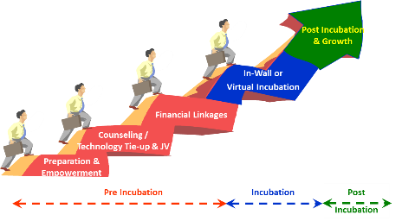





Intel & UNIDO Virtual Innovation HUB Framework
Enterprise Development & Investment Promotion Program
Innovation HUB
Partnerships
Empowerment
Certification
Funding
Policy
Business
Counseling
Contests
Technology
Impact : 1,000,000 youth by 2020
Notes:
- Enterprise Development & Investment Promotion Program: (implemented in 48 countries) A package approach aimed at promoting foreign direct investment through the facilitation of domestic investment
Value Proposition :
In order to develop entrepreneurship and innovation as fundamental drivers of sustainable growth and development and increase employability in the MENA & Africa region.
Intel & UNIDO Team will…
Use technology to catalyze a movement that prepare youth for a future career.
Establish a network of local and regional partners to increase access to employment resources (funding, mentors, advisors, networking opportunities .)
Provide skills training ( Job acquisition skills, 21st century skills, Business and entrepreneurship skills.)
Increase motivation & Engagement ( attitude toward education and training, motivation and participation in opportunities. )
We can do this because…
Our visionary organization’s commitment to support innovation for employability.
We have strong track record of impact on youth employment and innovation.
Ability to create partnership and scale in alignment with the ecosystem.
Our efforts will result in…
Increasing employability and entrepreneurship in MENA and Africa region and reach 100,000 Youth by 2019.
Accelerating development & National Competitiveness goals for the MENA & Africa policy makers.

Slide 11
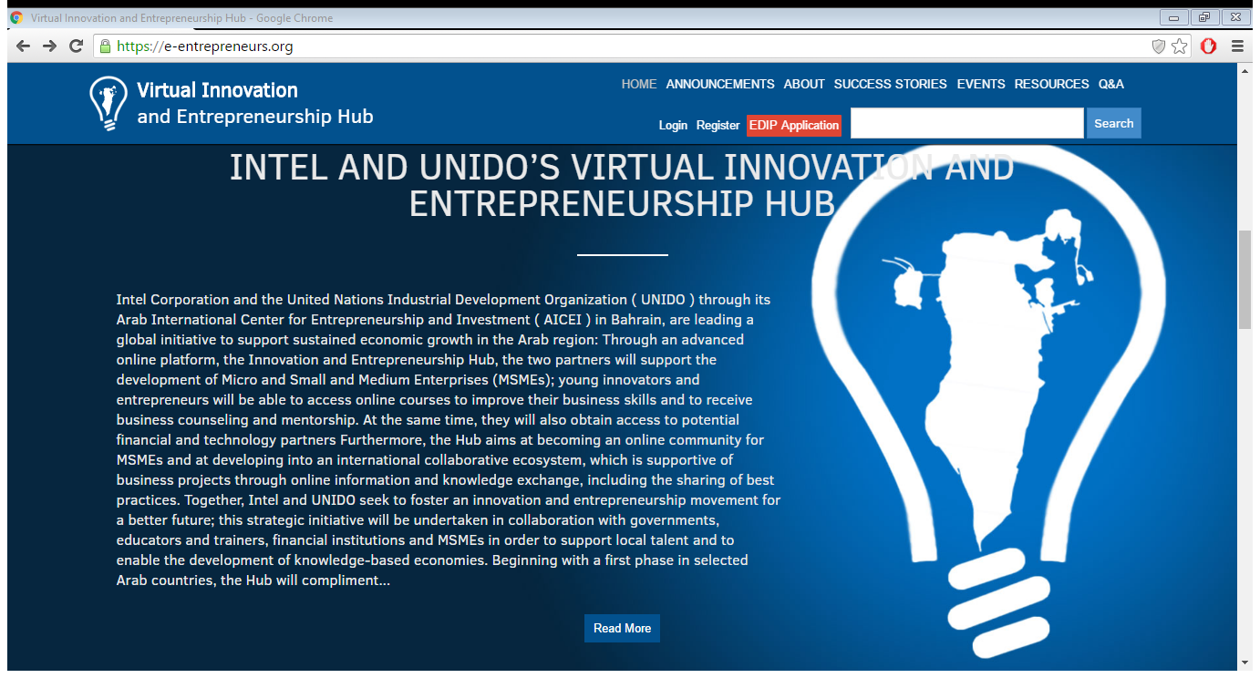
www.e-entrepreneurs.org

Slide 12

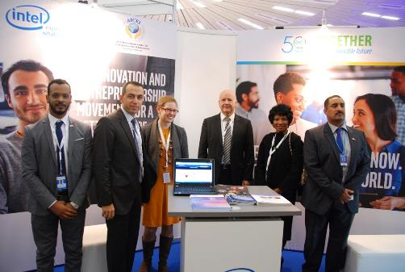
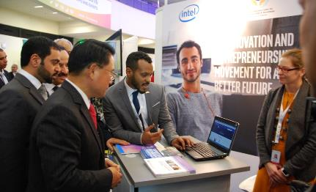
Launch of the UNIDO – INTEL Virtual Entrepreneurship & Innovation Hub
Official was held during the event.
Through the advanced online platform, the two partners will support the development of Micro and Small and Medium Enterprises (MSMEs); young innovators and entrepreneurs.
Virtual Entrepreneurship & Innovation Hub
e-entrepreneurs.org

Slide 13








Thank You
Questions?
Follow us on Social Media
@UNIDOBahrain

