Slide 1
Branding & Marketing Secrets UNIDO ITPO Bahrain AbdulRahman Al Awadhi +973 32219210 a.awadhi@arceit.org

Slide 2
What is Marketing?
A Complete Cycle:
1. Market Identification
2. Market Understanding
3. Market Engagement

Slide 3
Why Do We Market/ Brand?
Connect with our market:
Behavior / Identity / Emotion / Routine
Promote our products / make ourselves known
Differentiate from the competitors

Slide 4
Case Study: Evian

Slide 5
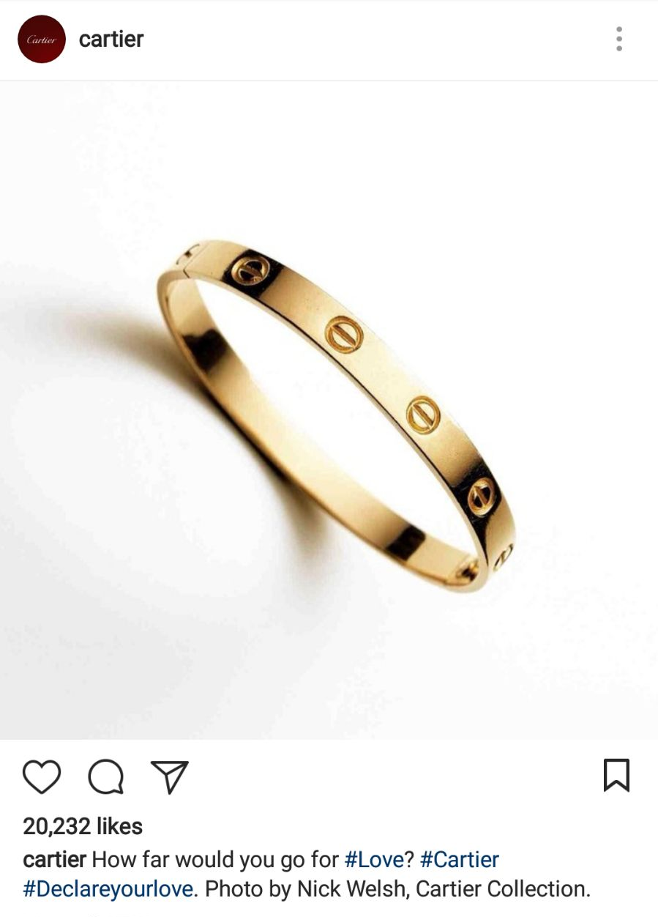
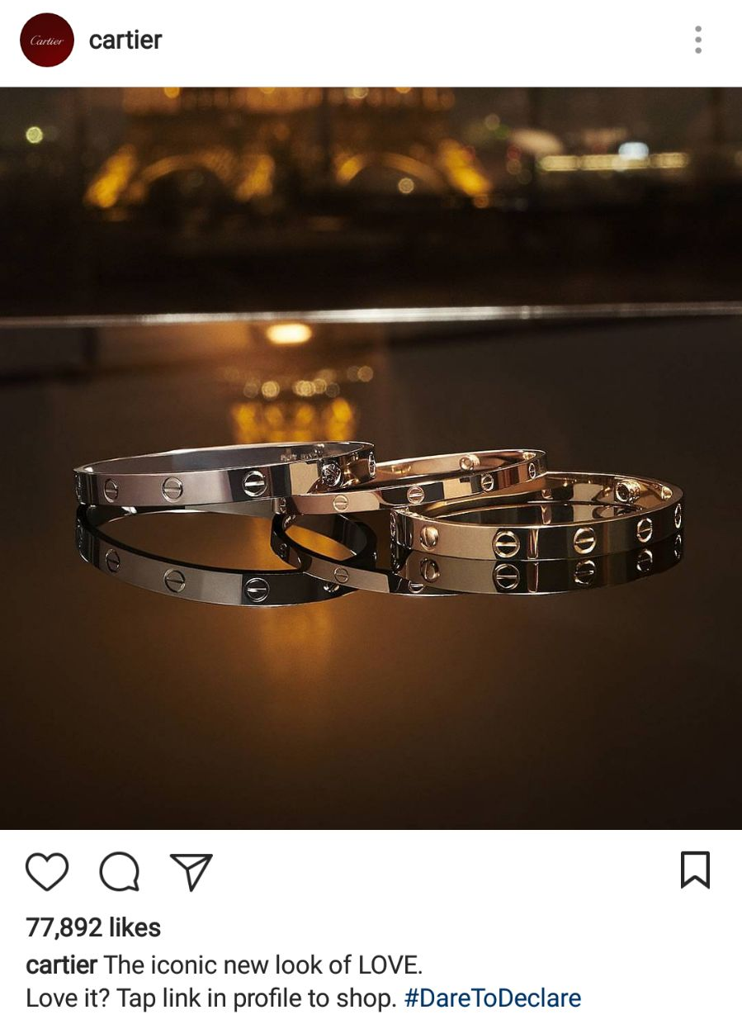
Case Study: Cartier

Slide 6
Case Study: Rolex

Slide 7
Ideal Results from Marketing
Create / Increase loyalty
Increase sales and growth prospect
Increase our prices

Slide 8
Creating the Concept: The Birth of a new Brand
Critical – Effect on Business
Starts and Continues with Homework
Innovative and Creative Solutions

Slide 9
1. Identifying the Market
Demographics
Competitor Profiles
Market Share
General Economic Factors

Slide 10
Targeting the Right Demographic
gender race (ethnicity) age (date of birth) household income home ownership (length of residence, home size, mortgage) disabilities |  | education employment status children location type of car(s) marital status (head of household, spouse) savings

Slide 11
2. Understanding the Market
Research
Observation
Feedback

Slide 12
3. Engaging with the Market
Tools
Approaches
Mediums

Slide 13
Define the Marketing Message
Define an image and a message that is relevant and appealing to the audience about the company and/or product, while adhering to the values of company.
1. Define the values of the company
2. Structure a marketing message linked to audience
3. Propose an appealing marketing image

Slide 14
Marketing Tools
Instagram
Facebook
Google Search
Snapchat
Freebies
Word of Mouth
Banners
Signboards
Twitter
Publications
Lamp Posts
Partnerships

Slide 15
Price vs Value Marketing
Difference
Solutions of Value Marketing
Examples

Slide 16
Price Marketing Limitations
(Business Side)
Reduction in product value (through repeated reduction of costs),
Damage to the product/business/industry/economy image (seen by customers as cheap, and expected to remain cheap),
Restricts business appetite and risk-taking (exploration of new approaches),
Discouragement of new entrants or smaller players,
Forcing of monopolization, business cannibalism, and unhealthy competition,
Forcing of all market players to engage in hopes of survival (epidemical),
Propagates an unhealthy culture of neglect to customer-needs,
Destroys any positive spillover effect (business restricts payments to suppliers, stops corporate social responsibility initiatives, and pay their employees and stakeholders ungenerously).

Slide 17
Price Marketing Limitations
(Consumer Side)
Reduced levels of customer satisfaction (lower product value and reduced value-added services, among others)
Reduced address to customer needs (in either an obvious or unique way)
Reduced variety to the customer (less businesses around to offer)
Reduced levels of understanding to customer (no mandate to research their needs)
Positioning of the price manipulator or marketing “liar” as the market winner

Slide 18
Value Marketing
Learning By Examples
Vehicles:
(Price) “Lowest priced 4X4 Jeep at BD4,999*! No Downpayment, No Sponsor, and No Transfer of Salary!
(Value) “Happy Professional Woman’s Day! A special choice of vehicle, exclusively for women professionals. Our complimentary service package and drop off will assure you that you never need to worry nor waste time with maintenance. Sponsored by the Bahrain Businesswoman’s Society, and now in your favorite color. Test drive is available from your office at the time of your choice.” (Exclusivity, Identity, Loyalty, Appeal, Image, Service, Status, Convenience)

Slide 19
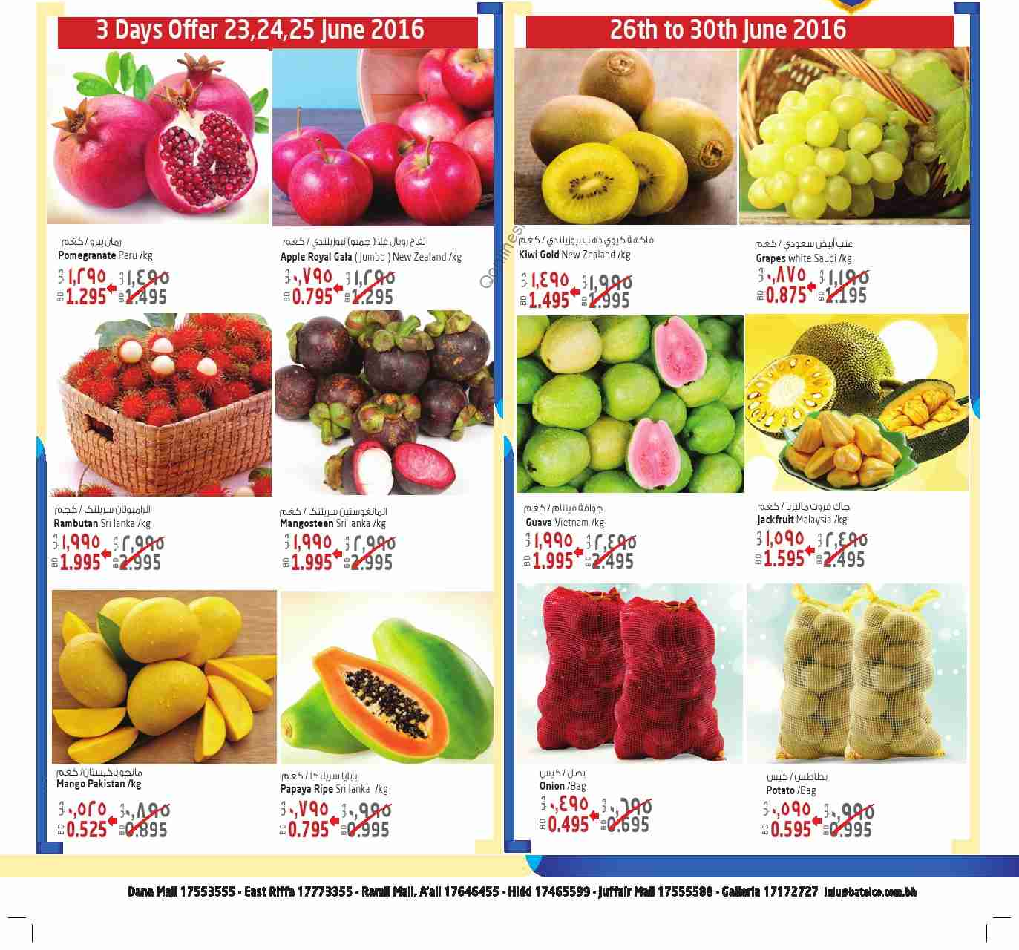
Value Marketing
Learning By Examples
Agriculture:
(Price) “3 boxes of tomatoes for the price of 1!”
(Value) “Fresh organic sun-dried tomatoes from your local farm, and now available at most hypermarkets. Our farm is open to all visitors, so come by and enjoy a walk around! Why import when you can support Bahrain and your community! Please also ask about our delivery service, and visit our new website for more details!” (Added Value, Quality, Accessibility, Health, Community Support, National Responsibility, Fun, Service)

Slide 20
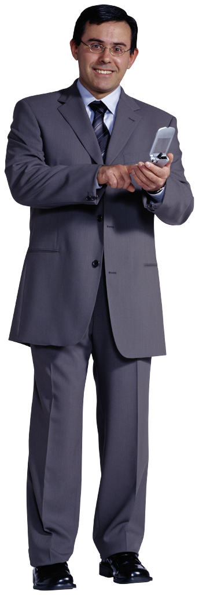
Value Marketing
Learning By Examples
Business Services:
(Price) “We now offer our services at lower prices, and your first consultancy session is free!”
(Value) “Pick up your leaflet on The Best Management Techniques in Bahrain, or have it delivered to you – containing current obstacles faced by Bahraini businesses and the responses we recommend. Is your business ready to take on these challenges? Book an appointment with our expert on 39123123” (Complimentary Market Information, Advice, Assurance, Integrity, Reputation)

Slide 21
Value Marketing Solutions
Fosters innovation in products, services, and business image,
Promotes creativity and relevance in advertised marketing message,
Allows unique understanding and engagement with the market,
Focuses on provision of value and comfort to clients (addressing needs),
Allows increased competition, while each maintaining uniqueness in approach,
Allows room for price increases and resulting improved profitability,
Creates improved liquidity and cashflows in market (improved spillover),
Promotes industry move towards creating and delivering quality,
Focuses on improved levels of customer satisfaction
Increases growth potential and allows business to address neighboring/additional markets

Slide 22
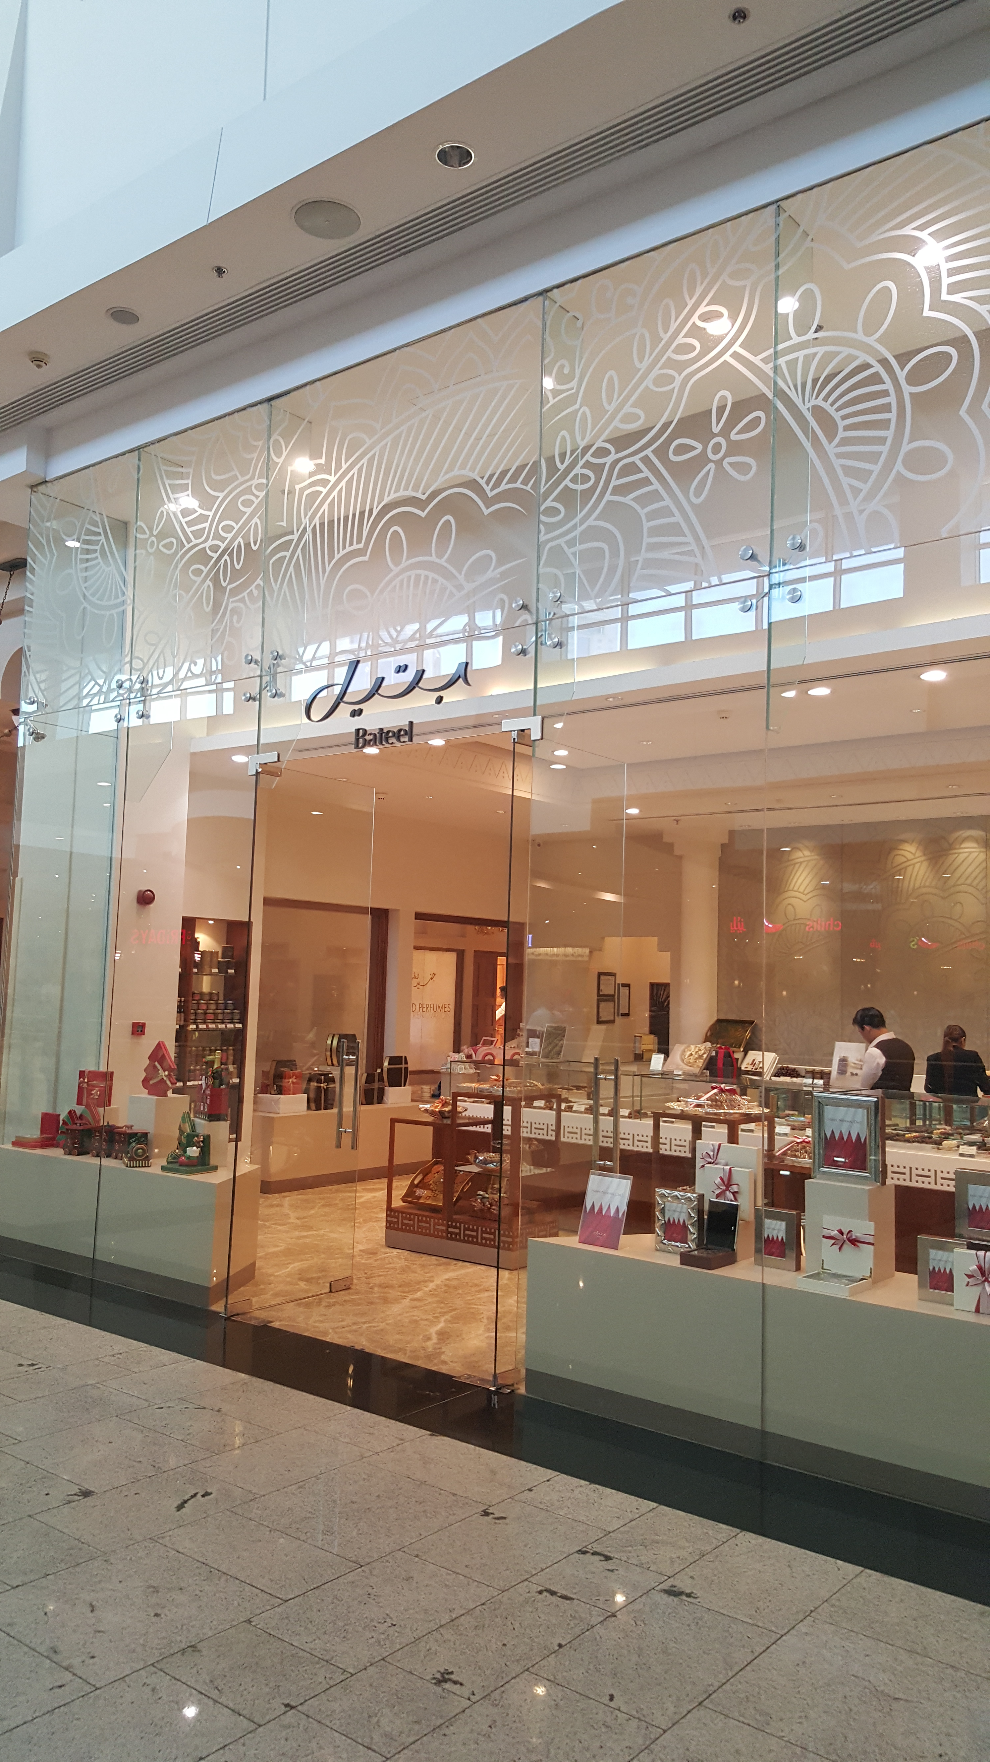
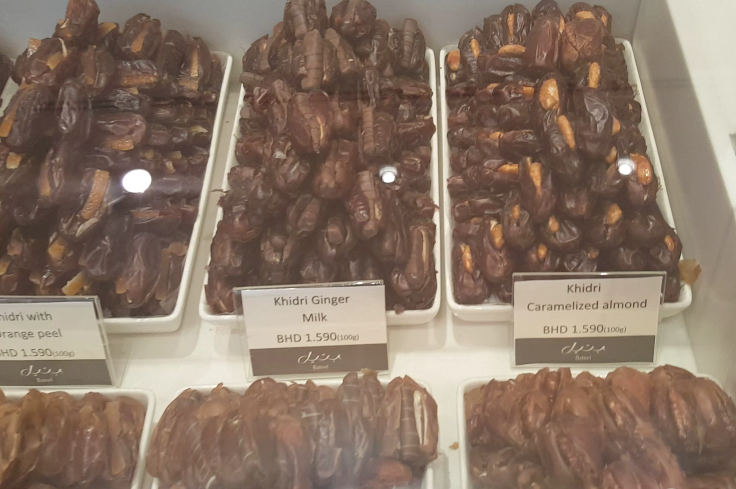
Successful Examples: Bateel

Slide 23
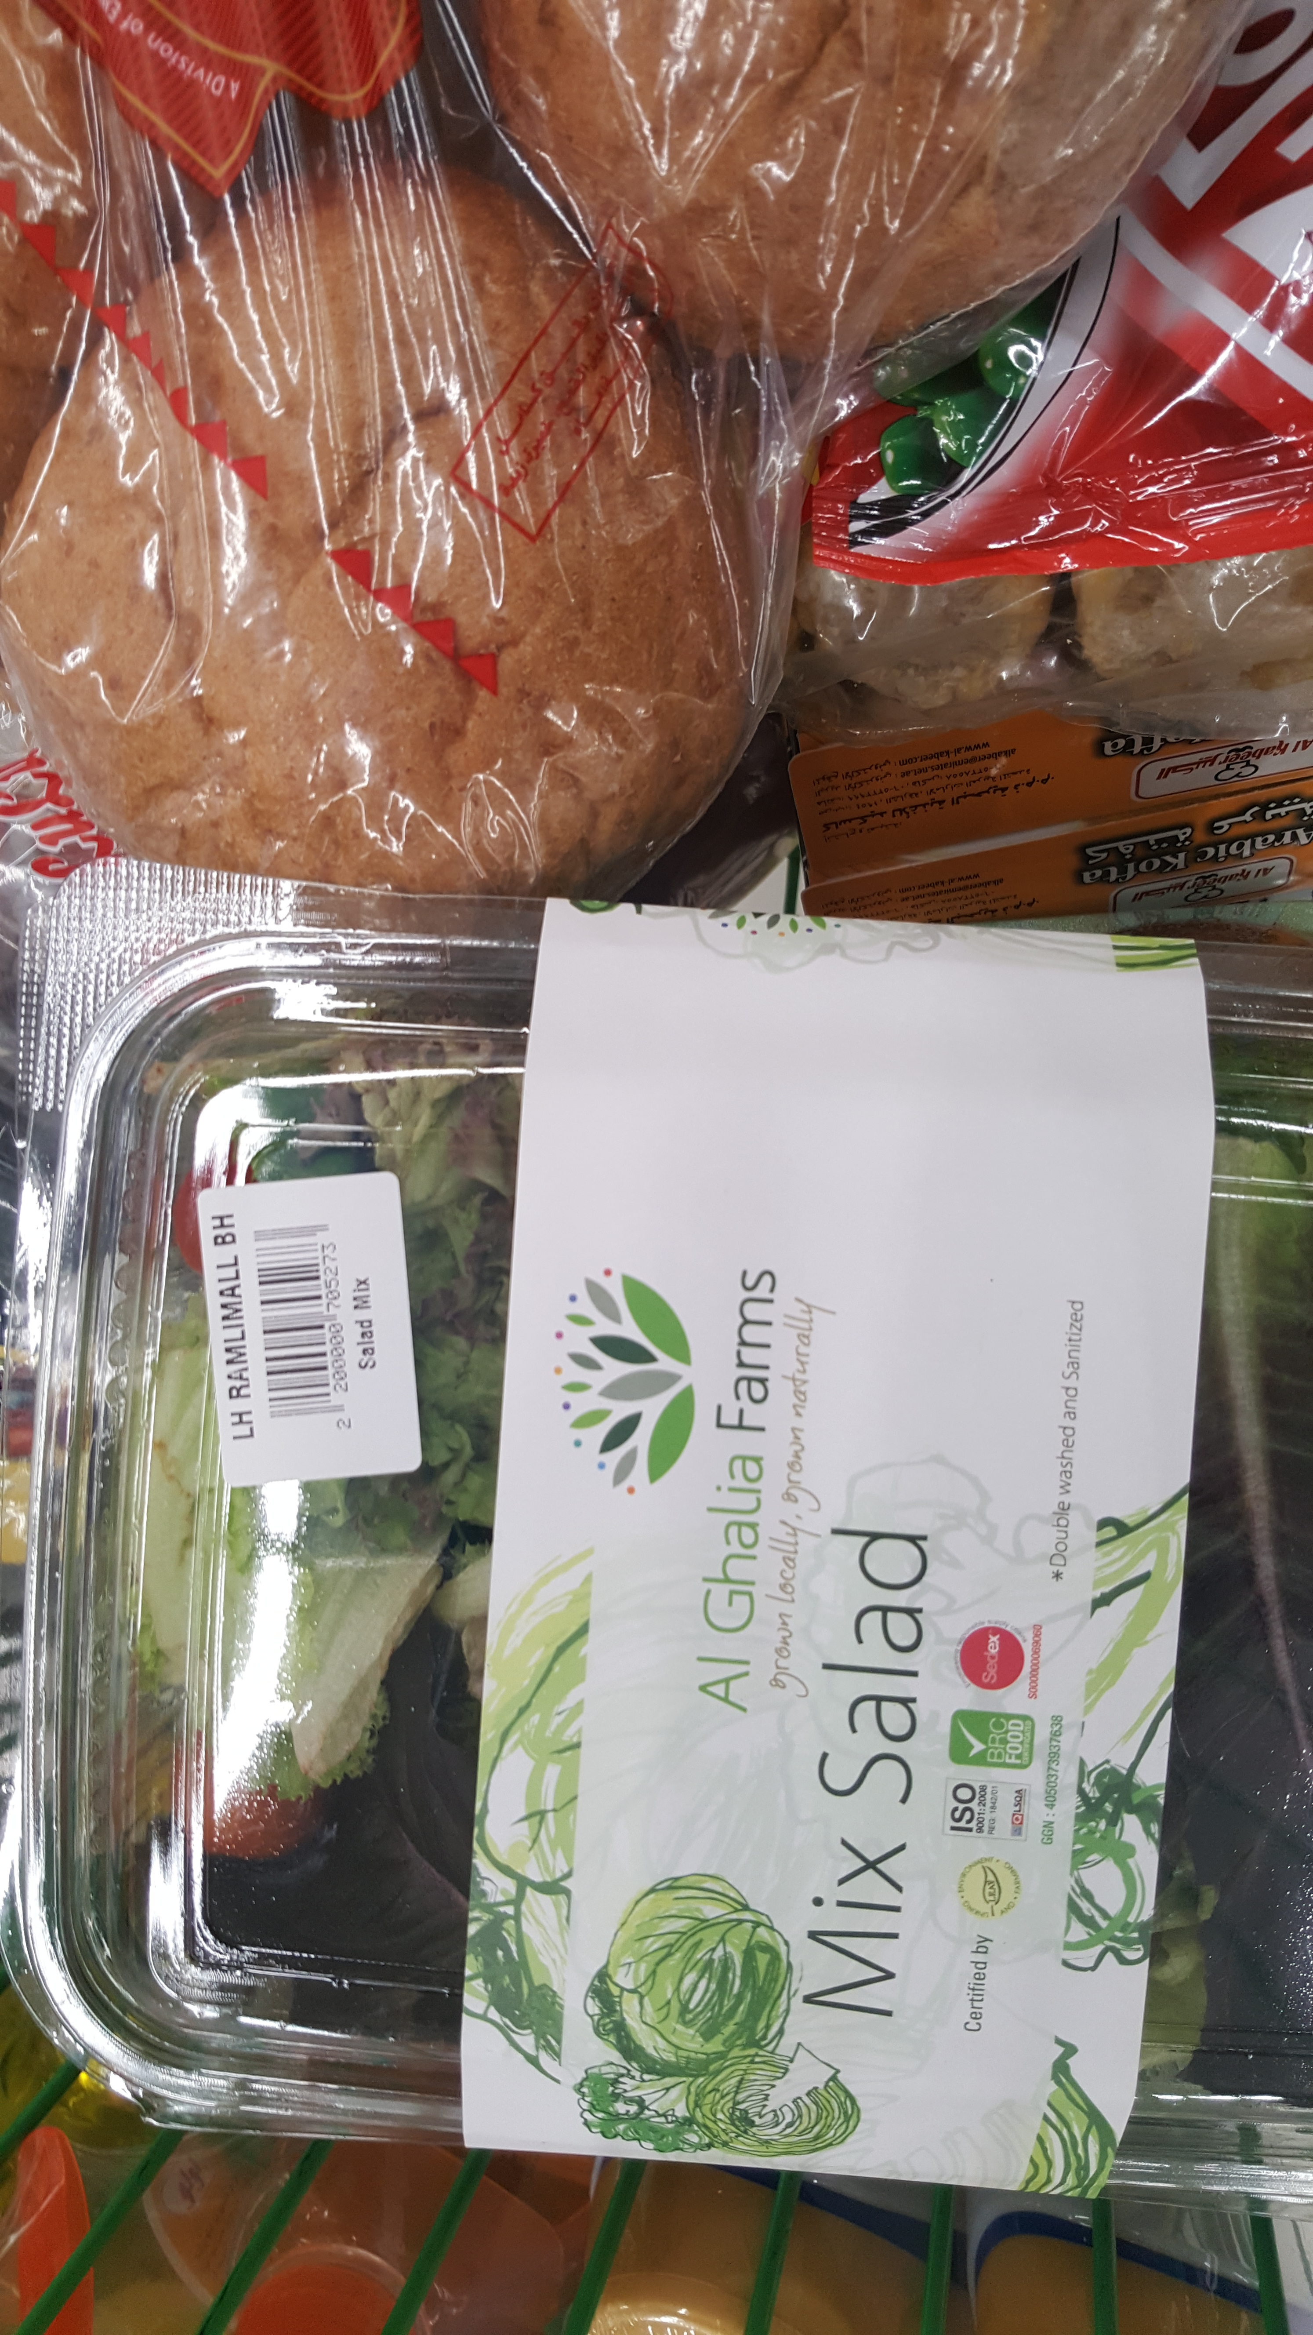
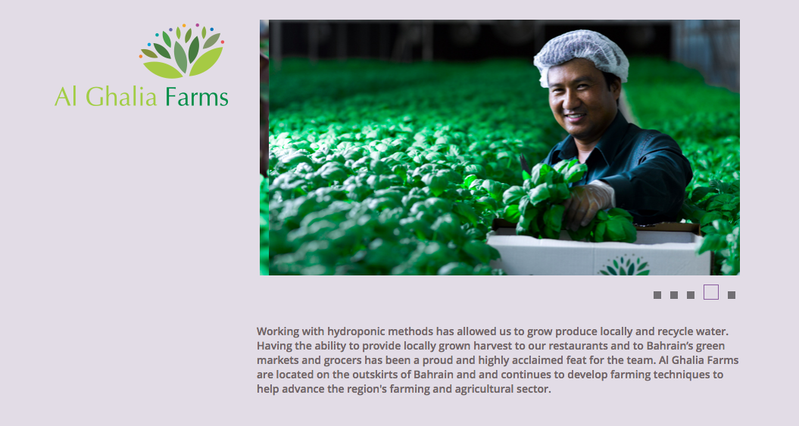
Successful Examples: AlGhalia Farms

Slide 24
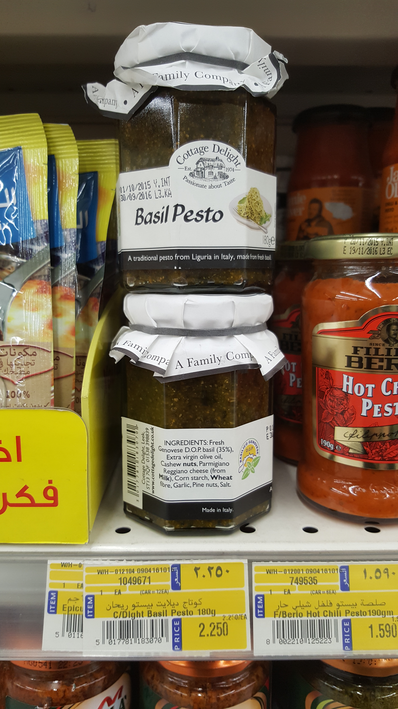
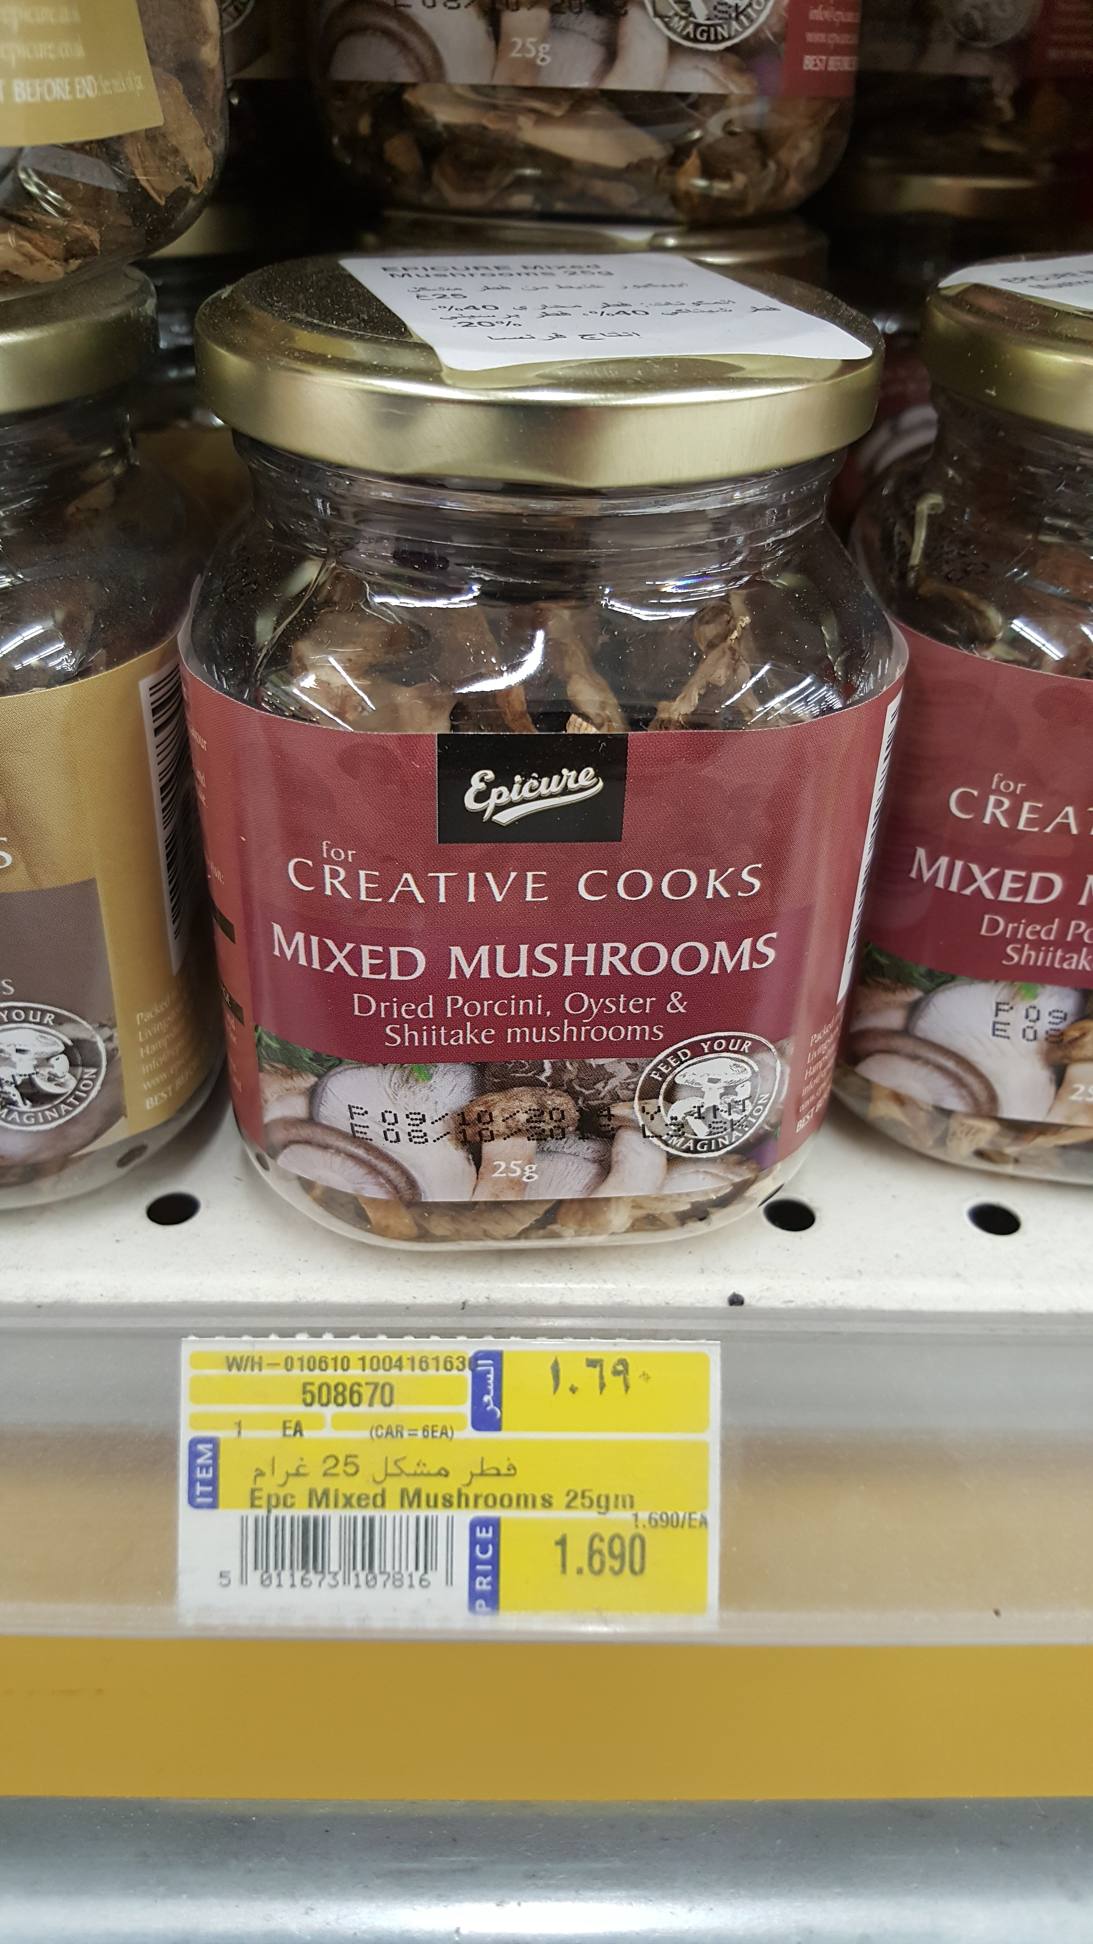
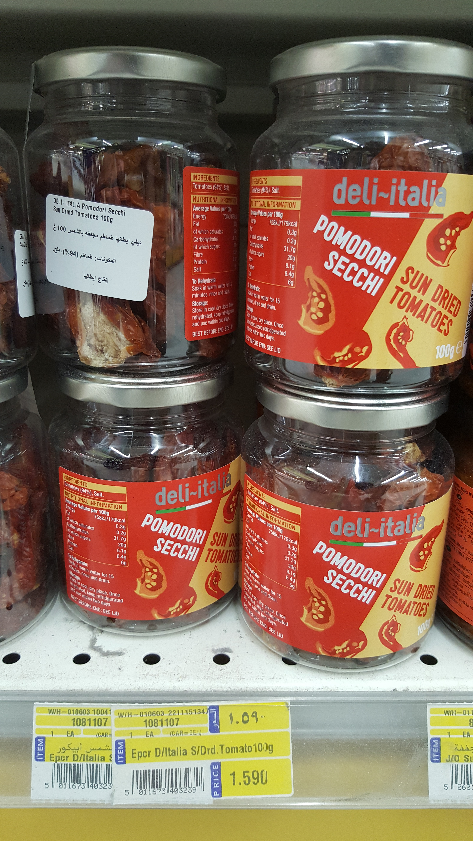
Successful Examples: Value-Add Products

